Slide 1
CSE 130 – Algorithm Design Loops Class 20
Winter 2023
Brother Godderidge

Slide 2

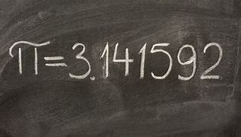

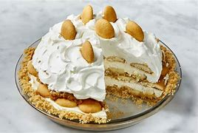
Happy PI Day

Slide 3
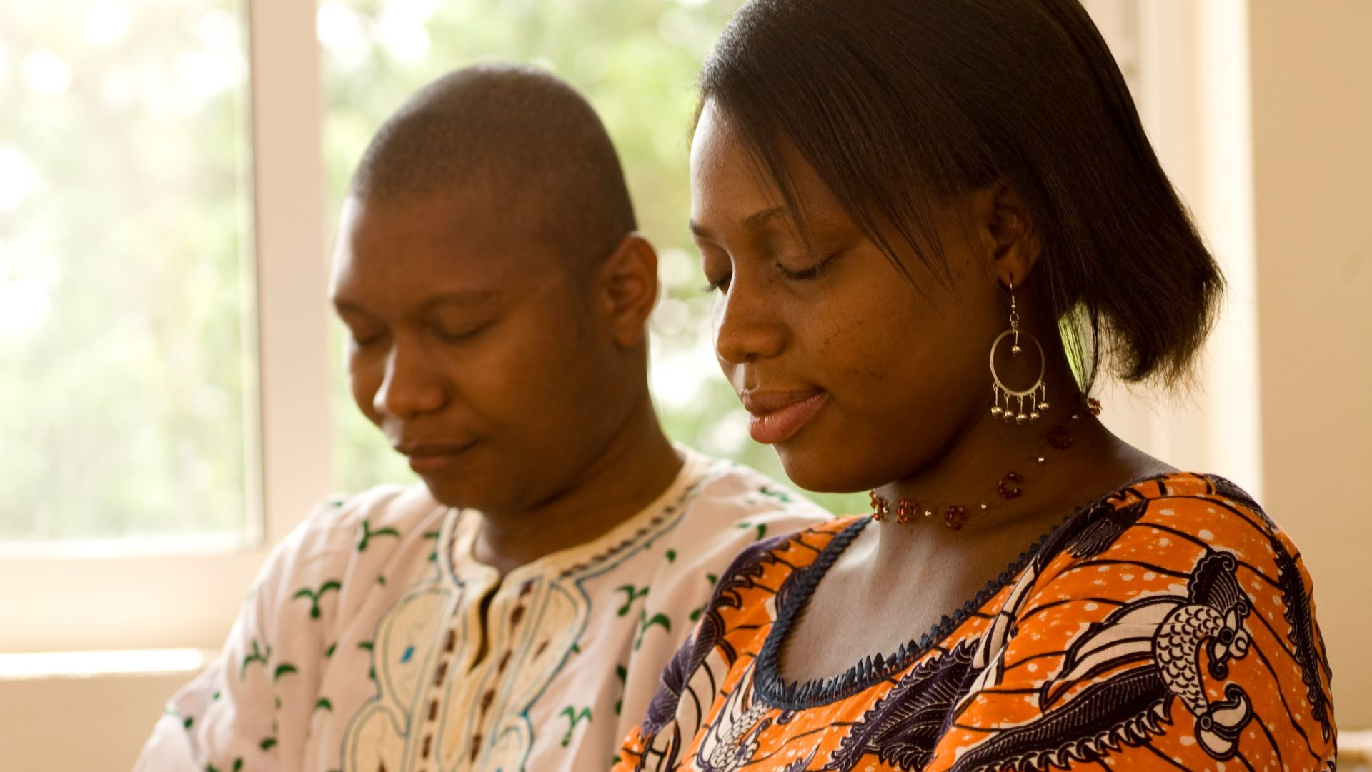
Opening Prayer

Slide 4

Spiritual Thought
2nd Nephi 268
30 For behold, thus saith the Lord God: I will give unto the children of men line upon line, ªprecept upon precept, here a little and there a little; and blessed are those who hearken unto my precepts, and lend an ear unto my counsel, for they shall learn ^{b}wisdom; for unto him that ^{c}receiveth I will give ^{d}more; and from them that shall say, We have enough, from them shall be taken away even that which they have.
Notes:
How does us coming unto Jesus help us? Help others?

Slide 5
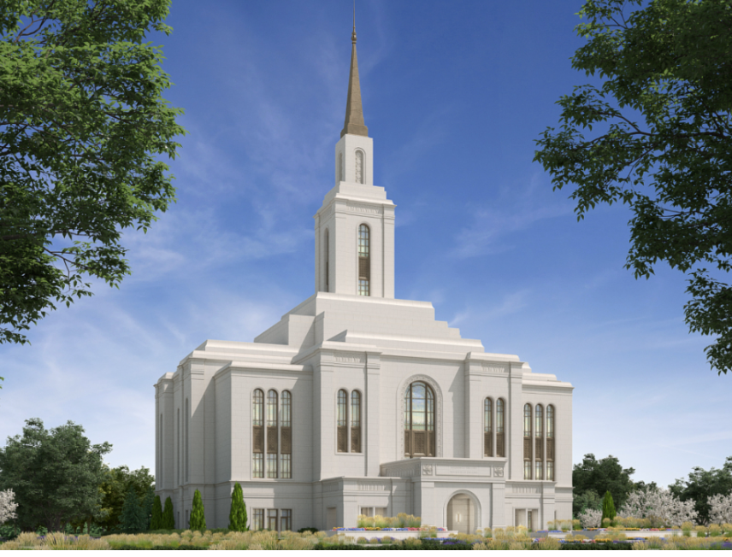
Teton River Temple
Groundbreaking – June 1st

Slide 6
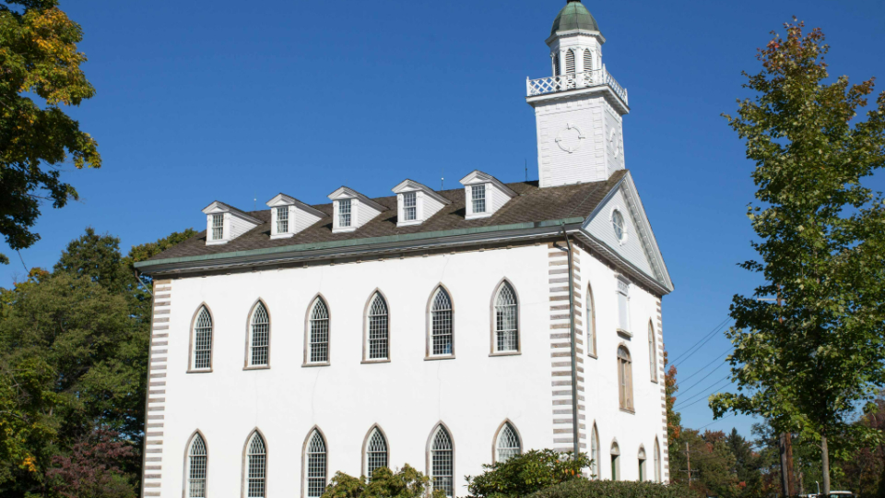
Church now owns Kirtland Temple
Also additional properties in Nauvoo, plus purchased many documents and artifacts
Frequently Asked Questions Clarify the Transfer of Sacred Sites and Historic Do (churchofjesuschrist.org)

Slide 7
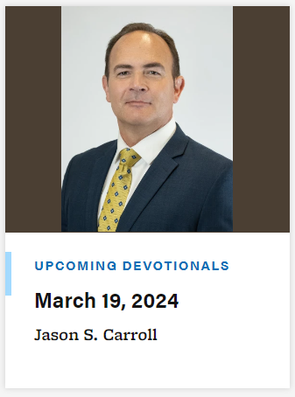
Devotional

Slide 8

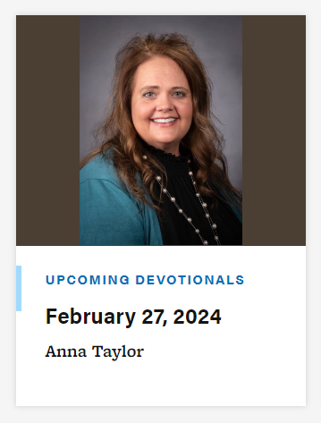
Devotional

Slide 9


Every Tuesday, Thursday, and Friday
3:30 – 6:30 PM

Slide 10

Computing Society - Wed, 5:00 - 5:30 STC398
Teams:
Cloud Solutions - Thursdays, 5:00pm STC 353
Cybersecurity - Thursdays, 7:00pm STC 295
Coding Interview – Thursdays, 5:00pm STC 385
Data Science/AI - Wednesdays, 5:30pm STC 398
Formula Hybrid+Electric - Tuesdays & Thursdays, 6:00pm AUS 213
Game Development - Thursdays & Fridays, 6:00pm STC 385
IEEE - Tuesdays, 5:30pm STC 243
Operating Systems Development - Wednesdays, 5:30pm STC 361
SWE (Society of Women Engineers) - Wednesdays, 5:30pm STC 341
UAS/Drone - Thursdays, 5:00pm MC 101
Web Design & Development - Wednesdays, 5:30pm STC 221
Mobile Development, Wednesdays, 5:30, STC 252
SHPE, Thursdays, 5:15, STC 341

Slide 11
Announcements
Societies:
Amateur Radio, 1st and 3rd Wednesdays, 6:00-7:00pm, STC 252
Brain Control Technology, Tuesdays 6:30pm, STC

Slide 12
Announcements
Societies:
Upcoming Events:
13 Mar (Wed) – Computing Society - 5:00pm STC 398
Join us in decoding job landscapes and playing a fun ninja game. We will have banana splits!
13 Mar (Wed) – SWE Wellness Night – 5:30pm STC 341
Recharge your spirit and conquer end-of-semester stress at the Society of Women Engineers Wellness Night this Wednesday at 5:30 PM in STC 341! Join us for an evening of rejuvenation featuring soothing activities like yoga, a lesson in meal prepping, and an insightful talk by a THRIVE speaker on overcoming imposter syndrome and burnout through the power of positive habits. We've got snacks covered, so all you need to bring is yourself and a yoga mat if possible!
14 Mar (Thurs) – Cybersecurity “Threat Hunting" – 7:00pm STC 295
This week we have a professional coming from a company close to home. Gavin Rook graduated from BYU-I and is now a Security Engineer for Melaleuca: The Wellness Company. He is willing to teach us some tricks of the trade, including some well-known malware types and how to identify them safely. This is a great presentation for you if you're interested in Cyber and like to lock everything you own, twice. STC295 Thursday @7
14 Mar (Thurs) – Navy Nuclear Engineering Info Session/Q&A – 11:30am AUSTIN 204

Slide 13
Announcements
Academic Peer Mentoring - we have students that want to help you with any questions you may have about your major, what classes to take, how to get an internship, etc. Please reach out to us or Dallin Scott or Preston Coreless for more information.

Slide 14

Announcements

Slide 15
Announcements REU (Research Experience for Undergraduates) Site: Cloud Computing Security & Privacy this year
Hello undergraduate students, The department of Computer Science at Boise State University will be running a summer research program - REU Site: Cloud Computing Security & Privacy this year. When: 5/20/2024 - 7/19/2024 (9 weeks) Where: Department of Computer Science, Boise State University, Boise, Idaho Stipend: $6,300. Meals: $130/week for meals. Housing is provided for non-local students. Round trip flight: Cover up to $700. Application deadline: 3/22/2024 You can access the website of the REU CCSP for more information, or you can apply here. Feel free to reach out, if you have any questions.
Jyh-haw Yeh
Associate Professor
Co-director of MS Cybersecurity
Program Director of GenCyber Teacher Camp
Point of Contact for NACE-C, PoS and DoD CySP at BSU
Computer Science, Boise State University

Slide 16

University Forums

Slide 17

Department Forums
Thursday, April 4th – Dustin Hill from Disney

Slide 18
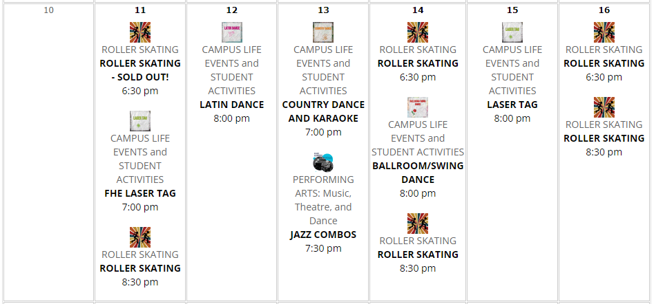
BYU Idaho Activities - March

Slide 19
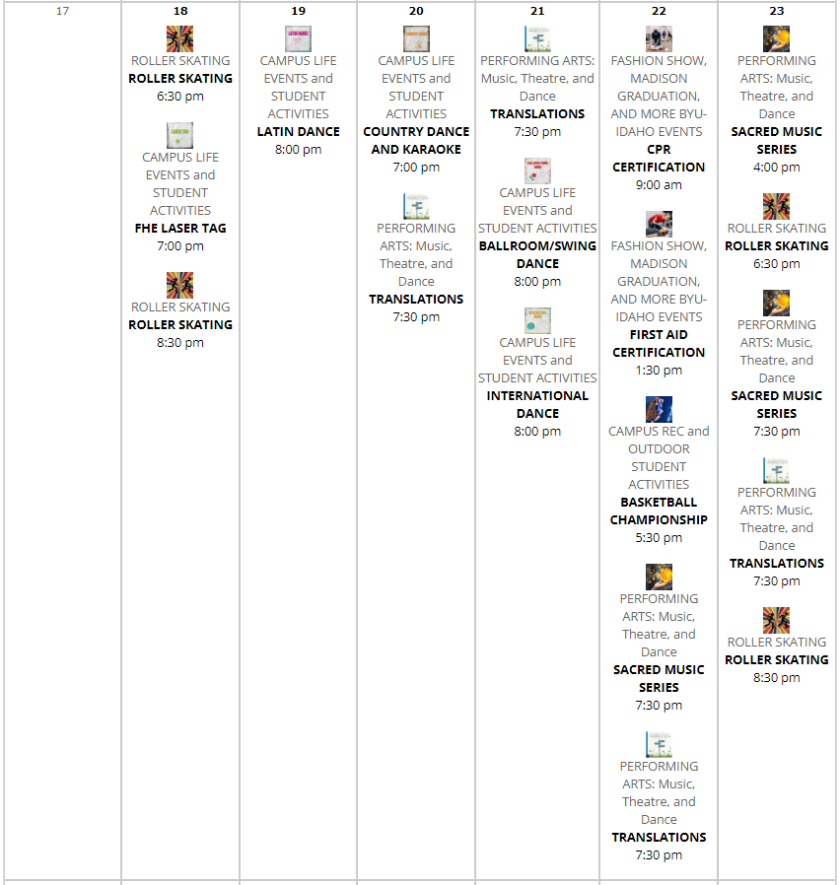
BYU Idaho Activities - March

Slide 20
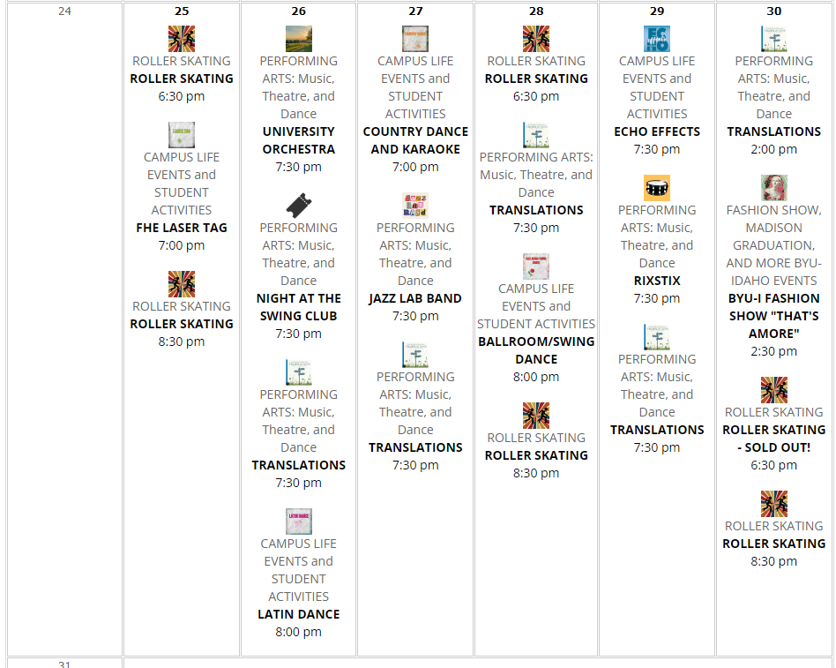
BYU Idaho Activities - March

Slide 21
University Help Resources
Dean of Students Office (byui.edu)
Kimball 290
208-496-9200
BYU-Idaho Counseling Center (byui.edu)
Student Health Center
208-496-9370
After hours – 24/7: 208-496-HELP(4357)
BYU-Idaho Wellness Center (byui.edu)
174 Hart building
208-496-7491
Welcome to the BYU-Idaho Tutoring Center (byui.edu)
2nd floor of the library
208-496-4270
Therapy Assistance Online (TAO): BYU-Idaho Counseling Center (byui.edu)
Online software to help
BYU-Idaho Student Health Center (byui.edu)
Health care and Pharmacy
208-496-9330
Autism Mentoring Program: BYU-Idaho Counseling Center (byui.edu)
Peer Mentoring (byui.edu)
208-496-1441
Many groups and workshops (contact counseling center)
THRIVE: 6 Week Anxiety and Depression Program - BYU Idaho Campus Recreation and Wellness Center Portal

Slide 22
University Help Resources
Student Services
Student Services (byui.edu)
Career services
Career Center (byui.edu)
208-496-9801
MC 200
Alumni Service
Alumni Association | Graduation Office | BYU-Idaho (byui.edu)
208-496-3300
MC 175
Presentation Practice Center:
Presentation Practice Center | Improve Your Public Speaking | BYU-Idaho (byui.edu)
208-496-3719
presentationpractice@byui.edu
IT
IT Services Home (byui.edu)
208-496-1411
Academic Advisor:
Email: CPSEadvising@byui.edu
208-496-9800
https://byu-idaho.screenstepslive.com/s/iplan_help_guides/m/68348/l/1021897-for-students-advising-appointment

Slide 23
University Help Resources
Accessibility Services Office
Mentoring, Student Disabilities, and Accommodations | Student Success | BYU-Idaho (byui.edu)
Career Center:
Career and Academic Advising | BYU-Idaho (byui.edu)
Mentoring, Internships, and Careers
Mentoring, Internships, and Careers (byui.edu)
Mentoring and Student Honors Office:
Mentoring & Student Honor | Student Success Mentoring | BYU-Idaho (byui.edu)

Slide 24
Use of AI - Summary
Generative AI Policy (byui-cse.github.io)
Encouraged to use AI technology to enhance learning, creativity, and productivity
Use to:
Generate or explore new ideas
Solve complex problems
Understand different approaches
Streamline repetitive and time consuming tasks
Code completion and debugging
Code understanding
Innovate solutions
Continuous learning
MUST Site use of AI in code documentation
NEVER USE THE STATEMENT: “I don’t know what this code does, I got it from chatgpt,”
You MUST use AI to help increase your understanding and ability – not to write your code.
You MUST understand what the AI generated code does!!!!
Notes:
.

Slide 25
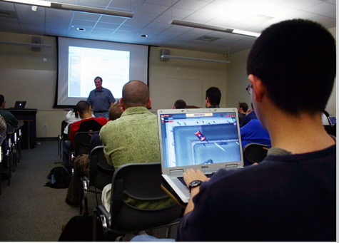
Class Policies
Talking – only one person at a time
Technology – Use for class
No games
No shopping
No videos
Class Roll/Attendance
Know who is here
Use for Grades are end of semester
Expect you to come to class
Contact me
Pass the class?
Attend class and turn in assignments . . .

Slide 26

Homework Policy
Homework – Don’t be Late!!
Turn something in on time
Unlimited re-submittals accepted
Contact me

Slide 27
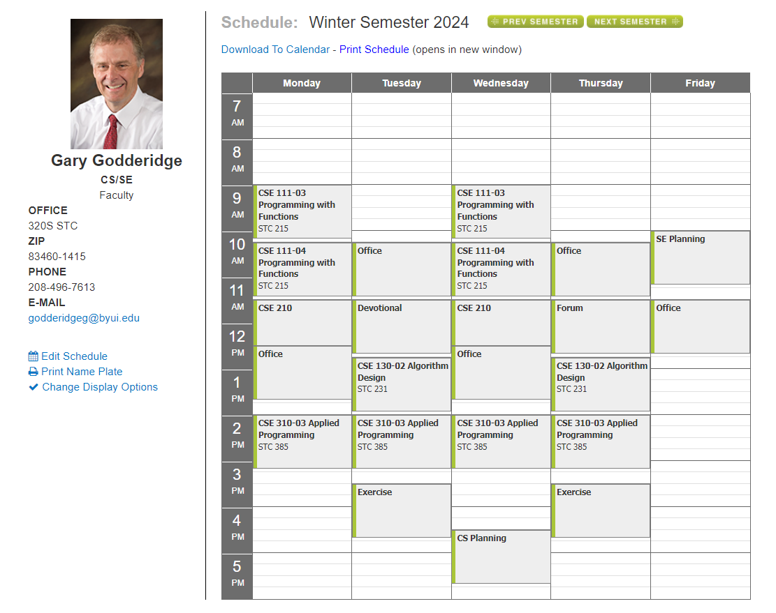

Slide 28

My MS Bookings:
Book time with Godderidge, Gary

Slide 29

Lighten Up
What’s the best way to catch a fish?
Have someone throw it to you?
What is a fish’s favorite instrument?
The bass guitar
What did the fish say when it hit a wall?
Oh Buoy!
- The Ultimate Dad Joke Book
Notes:
The computer will run the instructions one at a time – in order. Line upon line.
As in our previous examples, the computer runs our code in order.
Show another example.

Slide 30
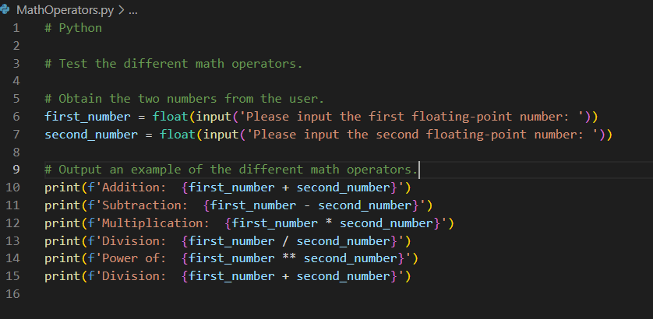
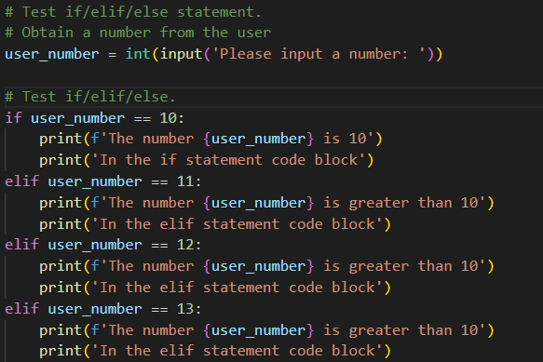
Coding Style/Standard
Variables Names – name it what it is, use underscores to separate words
E.g.,: last_name,
Spaces – use space before and after each operator:
E.g.,: rectangle_area = length * width
Blank Lines
Comments
One comment and one blank line per thought/idea
Code Blocks are indented by 4 spaces

Slide 31

Goals for Today
Review Homework
Review Loops
Loop Examples – Power of 2, n!

Slide 32
CSE 130 Course Outline
Week | Topic | Homework
1 | Course Overview | Guessing Game
2 | Python Review | Authentication Program
3 | Flowchart | Monopoly Design
4 | Decisions | Monopoly Program
5 | Pseudocode | Advanced Search Design
6 | Efficiency | Advanced Search Program
7 | Trace | Sort Design
8 | Assert | Sort Program
9 | Collections | Numerical Sequence Design
10 | Loops | Numerical Sequence Program
11 | Review | Review, Practice Final
12 | Maintainability | Prime Design
13 | Course Conclusion/Review | Prime Program
14 | Final Exam
Notes:
Slide 12 - Communication
Email, Ilearn Announcements, MS Teams Channel
I-Learn Notifications - show how to set announcements to immediate – so will receive an email.
MS Teams Channel - meant for broad discussions - questions and answers from all.
Have teams installed? Should have received and invite from Teams for this channel.

Slide 33
Course Final
Decision – Take the final Thursday April 4th
Review Tuesday March 19th
First Practice Final March 21st
Second Practice Final March 28
Review April 2nd
Final Thursday April 4th
Talk with me

Slide 34
Course Final – CSE 130Remaining Classes
Tuesday | Thursday
March 19th Review | March 21st – 1st Practice Final
March 26th Maintainability and review 1st Practice Final | March 28th – 2nd Practice Final
April 2nd – Review 2nd Final | April 4th – Final

Slide 35
Review Homework
Count Number Days between two Dates:
Examples
January 9, 2024 to January 20, 2024 -> 11 Days
February 2, 2024 to July 4, 2024 -> 27 + 31 + 30 + 31 + 30 + 4 = 153
From May 17, 1999 to November 10, 2005
14 + 30 + 31 + 31 + 30 + 31 + 30 + 31 + (228)
366 +
365 +
365 +
365 +
366 +
31 + 28 + 31 + 30 + 31 + 30 + 31 + 31 + 30 + 31 + 10 (314)
= 2369
Note – Three cases – same month, same year, across years

Slide 36
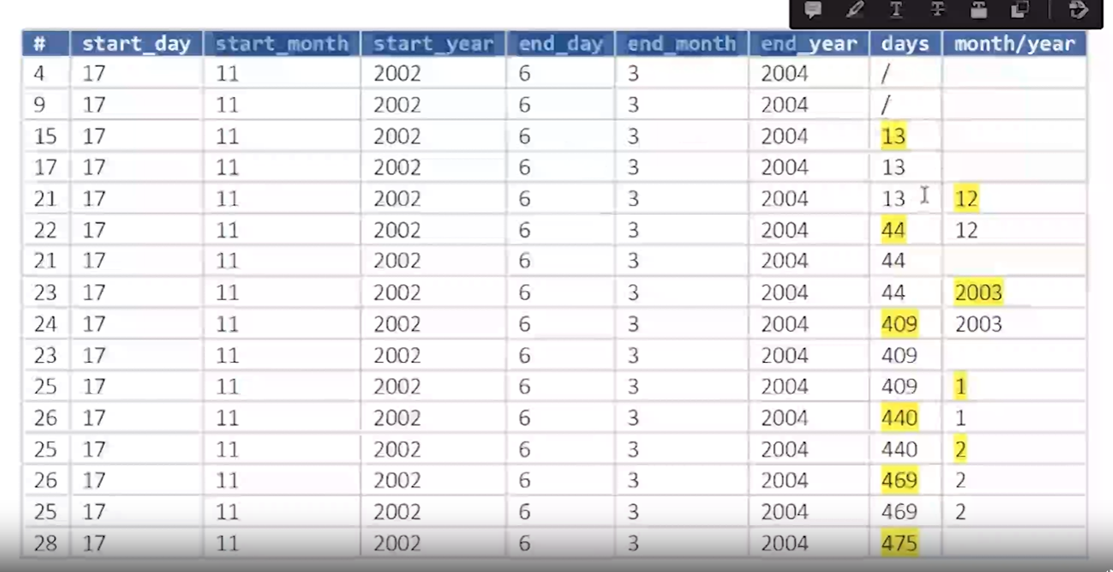
Review Homework

Slide 37
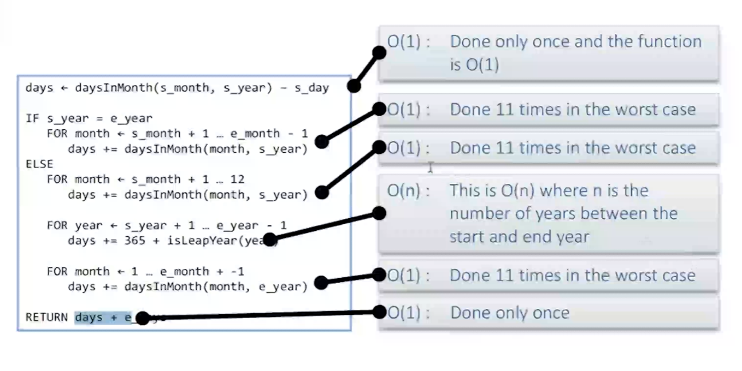
Review Homework

Slide 38
Loops
Event Controlled – until event (user input correct)
Counter Controlled – for number in range(100)
Sentinel Controlled – while not done
Collection Iteration
Index loop – for index in range(length of list)
Pointers – for (*p = text; *p; p++)
Linked Lists – for (p = head; p; p = p->next)
Iterator Loops – for (it = scores.begin(); it != scores.end(); it ++)
Instance Loops – for name in names_list:

Slide 39
Loops
Event Controlled – until event (user input correct)
Counter Controlled – for number in range(100)
Sentinel Controlled – while not done
Collection Iteration
Index loop – for index in range(length of list)
Pointers – for (*p = text; *p; p++)
Linked Lists – for (p = head; p; p = p->next)
Iterator Loops – for (it = scores.begin(); it != scores.end(); it ++)
Instance Loops – for name in names_list:

Slide 40
Loops
Event Controlled – until event (user input correct)
Wait for event, usually external – input from the user, network packet receipt, end-of-file from reading a file . . .
While expression can be a complicated
Sentinel Controlled – while not done
Wait for program state to change – e.g,. Hit the wall, run out of fuel, complete level
Can move complicated expression into the loop
While Expression is ALWAYS simple – e.g., not done
They are both while loops waiting for an expression to be False.
Difference is in the complexity and the determination/setting of the expression

Slide 41
Factorial
Write a program to calculate n!
n! = n * (n-1)!
factorial = factorial * n
What loop would you use?
Can you write this in all types? (counter controlled, sentinel, and collection)?

Slide 42
Lighten up
If FedEx and UPS merged, what would be the name of the new company?
FedUP – The Ultimate Dad Joke Book
What is the best thing about Switzerland?
I am not sure, but the flag is a huge plus – ibid.
Even at age 88, my mother was vain about her looks. At a party an old friend Exclaimed, “Edith, you haven’t changed in 20 years”.
“oh” said Mom, horrified
“I hope I didn’t look like this 20 years ago” – Laughter is the best Medicine
Three guys were in the forest when they saw some tracks.
The first said – “Hey Deer Tracks”,
The second said – “No, those are dog tracks”,
The Third said – “You are both crazy, those are cow tracks”
They were still arguing when they had to jump out of the way of the train – ibid
A French Guy accidentally caused the gas range in his kitchen to explode.
His neighbors have nicknamed him – Linoleum Blownapart . . . – The best joke book ever.
Geography Teacher: “Who can describe the English Channel?”
Student: “We don’t get that Channel on our TV” – Healing through Humor
Golfer to Caddy: You must be the world’s worst Caddy.
Caddy to Golfer: No Sir! That would be too much of a coincidence – The world’s greatest collection of clean jokes.
Notes:
IMPORTANT – STOP AND SHOW examples

Slide 43
Lighten up
Have you heard about the new band 1023MB??
They’re pretty good, but they don’t have a gig yet – The Ultimate Dad Joke Book
I was in the back of our ambulance tending to a patient when we slowed to a crawl.
Just ahead of us, a huge semi was hauling a house.
“Don’t you hate that”, said our driver,
“When people are simply too lazy to pack” – Laughter is the best Medicine
An Xray tech asked a little girl “Have you ever broken a bone?”
“Yes” she replied
“Did it hurt?”
“no”
“Really, which bone did you break”
“My sister’s arm”. – The best joke book ever.
“I would like some vitamins for my son,” a mother said as she walked into a pharmacy.
“Vitamins A, B, or C”, asked the pharmacist
“It doesn’t matter. He can’t read” – Healing through Humor
Why is a chicken soccer match a bad idea?
There are too many fowls – The Ultimate Dad Joke Book
Notes:
IMPORTANT – STOP AND SHOW examples

Slide 44
Lighten Up
Where do dad’s store their best dad Jokes?
In a dad-a-base - The Ultimate Dad Joke Book
How do you put a baby alien to sleep?
You rocket – ibid
Interesting Church Bulletin:
Don’t let work kill you off –
let church help. – The best joke book ever.
“How do you tell when you run out of invisible ink?” – Healing through Humor
Two boys were trying to out do each other. The first said: “My uncle is a doctor, I can be sick for nothing”
The second said “Big Deal, my uncle is a preacher.
I can be good for nothing.” – The world’s greatest collection of clean jokes.
Three boys were bragging about their fathers.
The first said: “My dad can shoot an arrow and reach the target before the arrow does.”
The second said: “Well, my dad is a hunter and he can fire his gun and reach the target before the bullet does.”
The third boy said: “That’s nothing, my dad works for the city. He stops working at 4:30 and gets home by 3:45” – Laughter is the Best Medicine
Notes:
IMPORTANT – STOP AND SHOW examples

Slide 45
Halftime Humor
Why did the pony need a drink of water?
He was a little horse. – The ultimate Dad Joke Book
What day of the week to chickens hide?
Fry-Day - Ibid
What do you call an owl that can do magic tricks?
Hoooooodini - ibid
As an amateur pilot wannabe, I knew I had made progress with my flight training the day my instructor turned to me and said:
“You know . . . you are not as much fun since you stopped screaming” - Reader’s Digest Laughter is the best medicine
I was leading a group of tour through the Carlsbad Caverns in New Mexico when a woman asked?
“How many miles of undiscovered passageways are there in this cave?” - ibid
My wife loves sales. She’ll buy anything that’s marked down.
Yesterday she came home with an escalator. - Ibid
Notes:
IMPORTANT – STOP AND SHOW examples

Slide 46
Algorithm Efficiency – Add Counter and Test to Find Efficiency
# Python
# Test Counting GrayScale pixels
import random
# Test varying image sizes
image_sizes = [4, 8, 16, 32, 64, 128, 256, 512]
# Check each image size for rows with signficant number of white pixels
for image_size in image_sizes:
white_pixels = 0
number_of_rows_with_significant_white_pixels = 0
# Check the entire image
for x in range(image_size):
# Reset count at the start of each row
white_pixels = 0
for y in range(image_size):
# Pick a random pixel value
pixel_value = random.randint(0, 255)
# Pixel value > 210 is mostly white
if pixel_value > 210:
white_pixels += 1
# A row with 15% or more white pixels is considered significantly white row
if white_pixels > image_size * 0.15:
number_of_rows_with_significant_white_pixels += 1
break
# Print out the number of rows in this image.
print(f'image size: {image_size}, number of white rows: {number_of_rows_with_significant_white_pixels}')
Notes:
Slide 12 - Communication
Email, Ilearn Announcements, MS Teams Channel
I-Learn Notifications - show how to set announcements to immediate – so will receive an email.
MS Teams Channel - meant for broad discussions - questions and answers from all.
Have teams installed? Should have received and invite from Teams for this channel.

Slide 47

Lighten Up – Groundhog Addition - 20 Funny Groundhog Day Jokes for Kids and Adults (today.com)
Does anyone know any good groundhog day jokes?
I keep hearing the same ones over and over and over again.
What is a groundhog’s favorite drink.
Hole milk
What did the French groundhog see when he woke up?
His Chateau
What is a groundhog’s favorite book?
Holes
What did the groundhog’s trainer tell him before the Olympics?
Gopher gold 20+ Hilarious Groundhog Day Jokes And Puns! | LaffGaff
The majestic Woodchuck, also known as a ground hog, which Begs the question:
How much ground would a ground hog hog if a ground hog could hog ground? The 22+ Best Groundhog Jokes - ↑UPJOKE↑
groundhog dad jokes - Bing images

Slide 48
Lighten Up
Why do you go to bed?
The bed won’t come to you ☺ - The Ultimate Dad Joke Book
What do you call a pig doing Karate?
Pork Chop - ibid
How do you get water in a watermelon?
Plant it in the spring – brother Kay
What two questions are impossible answer with YES:
Are you asleep? Are you dead? - ibid
Having looked the other way for weeks, the boss finally called Smith into his office for a sit-down.
“You know Smith”, the boss said, “I’ve noticed that every time you have to take your dear old aunt to her doctor’s appointment, there is a home game over at the stadium.”
“Wow, sir. I guess you’re right,” Smith said.
“I didn’t realize that. You don’t think she’s faking it do you?” - Reader’s Digest Laughter is the best medicine
Customer: “Can I please get your name and position with the company?”
Employee: “This is Ryan, and I am sitting down.”

Slide 49
Lighten Up
What is a snake’s favorite subject in school?
Hiss-tory – The Ultimate dad Joke Book
What do you call a million year old dinosaur?
A Fossil. – ibid
Why was the music student kicked out of school?
For taking notes – ibid
My sight-impaired friend was in grocery store with her guide dog.
The Manager of the store asked – “is that a blind dog?”
My Friend said: “I hope not, or we’re both in trouble”. – Laughter really is the best medicine
Parents spend the first part of a child’s life urging them to walk and talk.
And the rest of their childhood making them sit down and be quite.” – The world’s greatest collection of clean jokes.
Every day I beat my own previous record –
For the number of days I have stayed alive. The Best Joke Book Ever.
Interesting Sign – in a non-smoking area:
“If we see smoke, we will assume you are on fire and take appropriate action.” Healing through humor
Notes:
The computer will run the instructions one at a time – in order. Line upon line.
As in our previous examples, the computer runs our code in order.
Show another example.

Slide 50
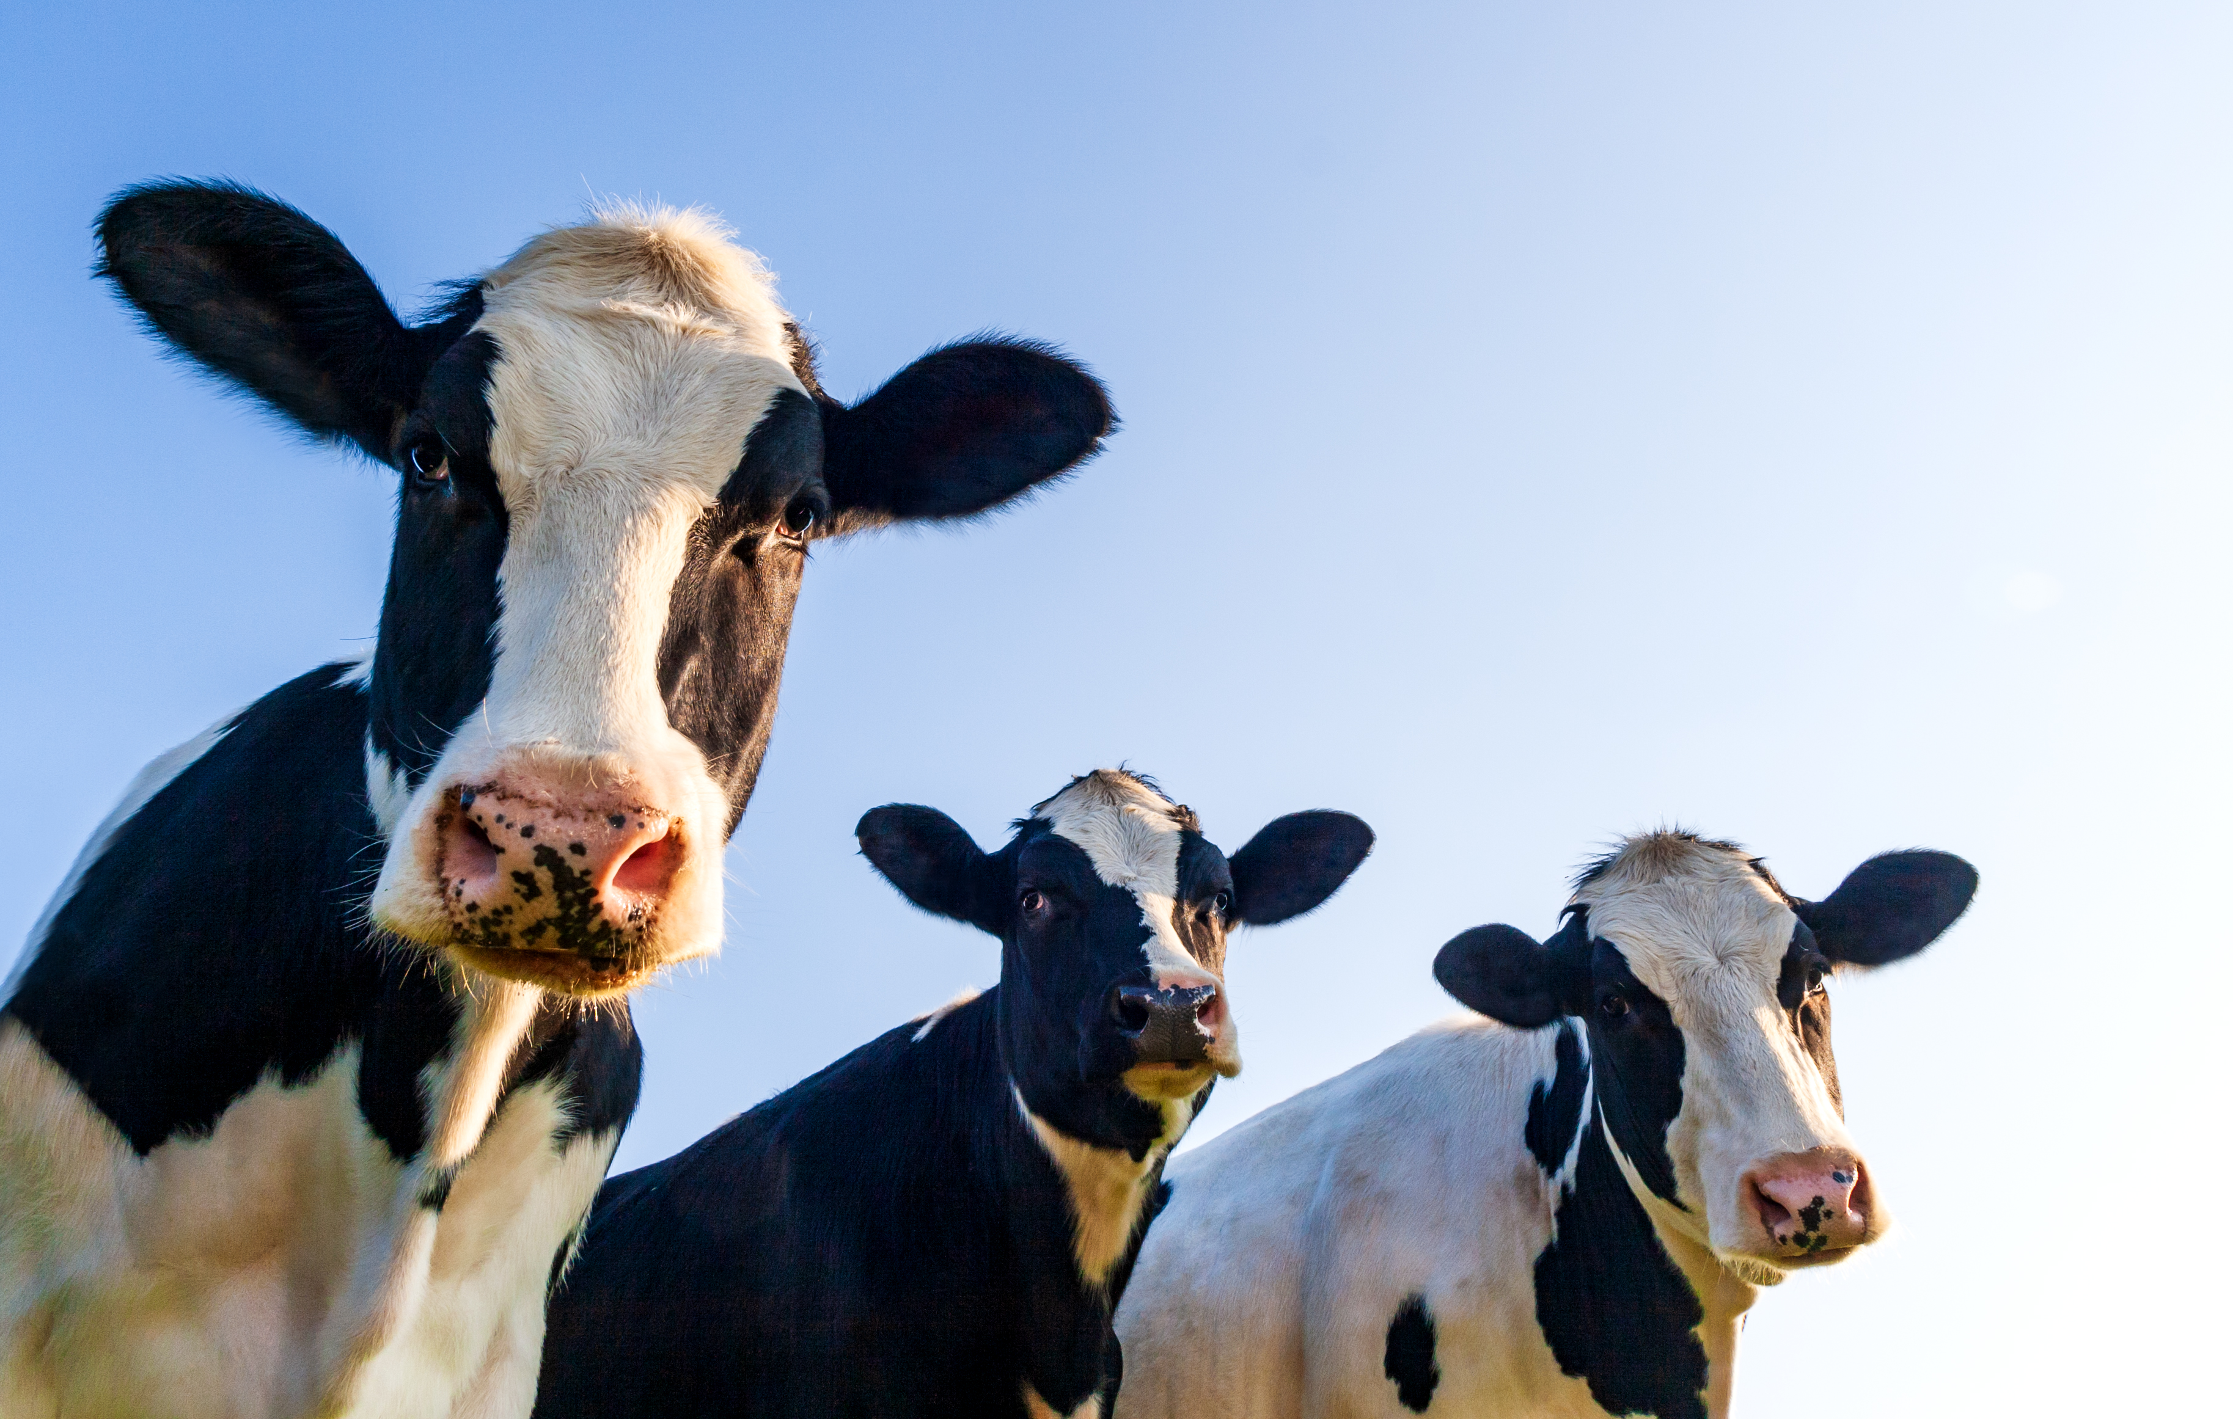
Lighten Up – Cow Edition
Where do cows display their artwork?
At the Moo-seum. – The Ultimate dad Joke Book
What do you call a cow in an earthquake?
A Milkshake. – ibid
What do you call a cow with 3 Legs?
Tri-Tip
What do you call a cow with 2 Legs?
Lean Beef
What do you call a cow with 1 Leg?
Steak
What do you call a cow with no legs?
Ground Beef
What do you call a cow who ran through a fence?
Shredded Beef
What did one cow say to the other?
Got Milk? 50 Cow Jokes That Are Udderly Hilarious | Reader's Digest (rd.com)
What do you call a cow that can’t make milk?
A milk dud – Ibid
What do you call a sad cow?
Moo-dy – Ibid
Notes:
The computer will run the instructions one at a time – in order. Line upon line.
As in our previous examples, the computer runs our code in order.
Show another example.

Slide 51
Lighten Up
Did you know that French Fries weren’t even made in France?
They were fried in Greece. – The Ultimate dad Joke Book
When do you stop at green, but go on red?
When Eating a watermelon – ibid
Buffalo were roaming on the range when a tourist passed by.
“Those are the mangiest-looking beasts I have ever seen” he said
One Buffalo turned to another and said, “I think I just heard a discouraging word” – Laughter really is the best medicine
What do you call a person who crosses the ocean twice without taking a bath?
A dirty double crosser.– The world’s greatest collection of clean jokes.
Someone knocked on my door and asked for a small donation for a local swimming pool.
So I gave them a glass of water. The Best Joke Book Ever.
Interesting Sign at an Electric Company: On a Plumbers Truck:
“We Repair what your husband fixed.”– Healing through humor
Notes:
The computer will run the instructions one at a time – in order. Line upon line.
As in our previous examples, the computer runs our code in order.
Show another example.

Slide 52
Lighten Up
What do you call a fly with no wings?
A walk. – The Ultimate dad Joke Book
Why wouldn’t the tiger eat the clown?
He thought it would taste funny – ibid
You didn’t have to be a brain surgeon to figure out that a customer at our post office was an off-duty mail clerk from another office. He wrote on his package –
“Fragile: Toss Underhand” – Laughter really is the best medicine
Billy was in a store with his mother when he was given a stick of Candy by one of the clerks.
“What do you say, Billy?” prompted his mother.
“Charge it” said Billy– The world’s greatest collection of clean jokes.
Attorney – She had three children – right?
Witness – Yes
Attorney – How many were boys?
Witness – None
Attorney – Were there any Girls?
Witness – Your Honor, I need a different attorney. Can I get a different attorney?. The Best Joke Book Ever.
Interesting Sign at an Optometrist’s Office:
“If you don’t see what you are looking for, you’ve come to the right place.”– Healing through humor
Notes:
The computer will run the instructions one at a time – in order. Line upon line.
As in our previous examples, the computer runs our code in order.
Show another example.

Slide 53
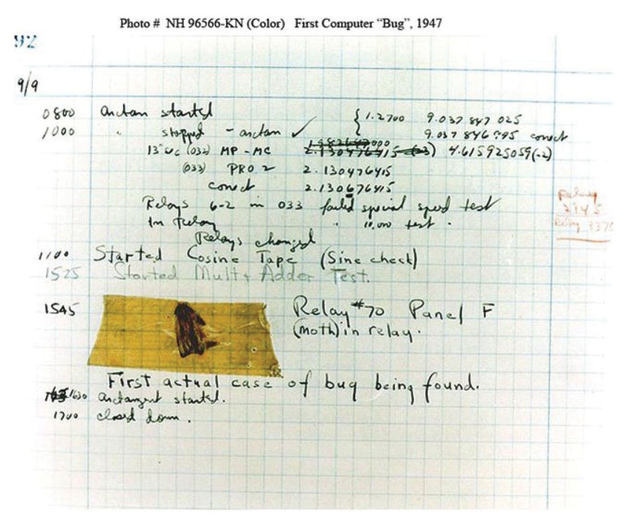
First Software Bug found
September 9, 1947

Slide 54
Program Trace
Trace is the process of systematically stepping through an algorithm one statement at a time to track how the values of the variables change through program execution.
During the trace process, you the programmer play the role of the computer. With each step of the algorithm, you write down on a sheet of paper how the program would change each of the variables. This technique is effective because most bugs have their origins in an incorrectly set value.
Test Case – selected input yields specific output
Number Lines
Create Table
Review Results

Slide 55
Python String Formatting
# Trace
print(f'{"Trace Table":12} {"n":>4} {"total":>7}’)
# Trace
print(f'{"Line 1":12} {n:4} {total:7}')
Output:
Trace Table n total
Line 1 1 0

